Slide 1

TWITTER CLONE IN WEB3
Group Members :
Le Thanh Hai – 20184254
Nguyen Tuan Dung – 20184246
Nguyen Phu Truong – 20184319
Tangi Jean Francis Le Gac – 2021T011

Slide 2
TABLE OF CONTENTS
01
02
03
INTRODUCTION
FUNCTIONALITY
Technology
Project introduction
All project function
Tool and framework

Slide 3
01
INTRODUCTION
Project Introduction

Slide 4

INTRODUCTION: TWITTER CLONE
LOGIN & LOGOUT
CREATE YOUR TWEET
VIEW YOUR PROFILE AND OTHER TWEETS
SETTING PROFILE

Slide 5
02
FUNCTIONALITY
All project function

Slide 6
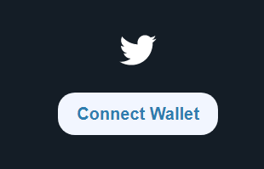
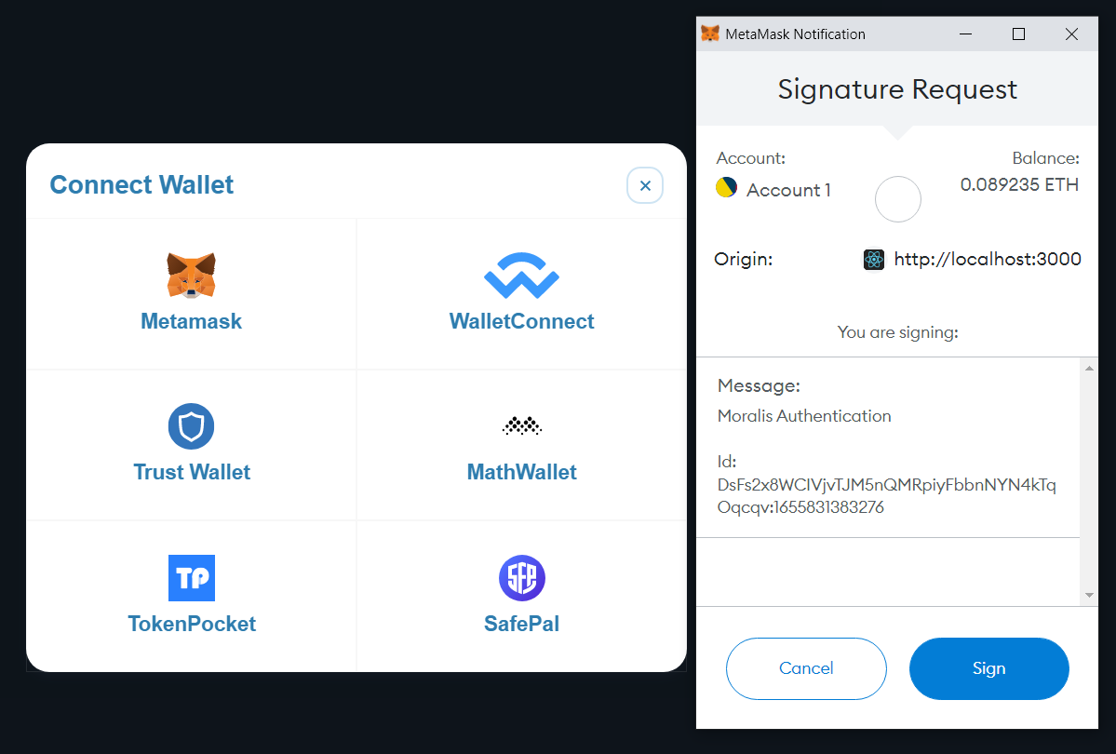
LOGIN & LOGOUT
Connect to MetaMask
Login Button

Slide 7
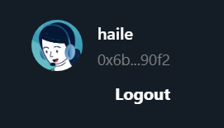
LOGIN & LOGOUT
Logout Section in HomePage

Slide 8
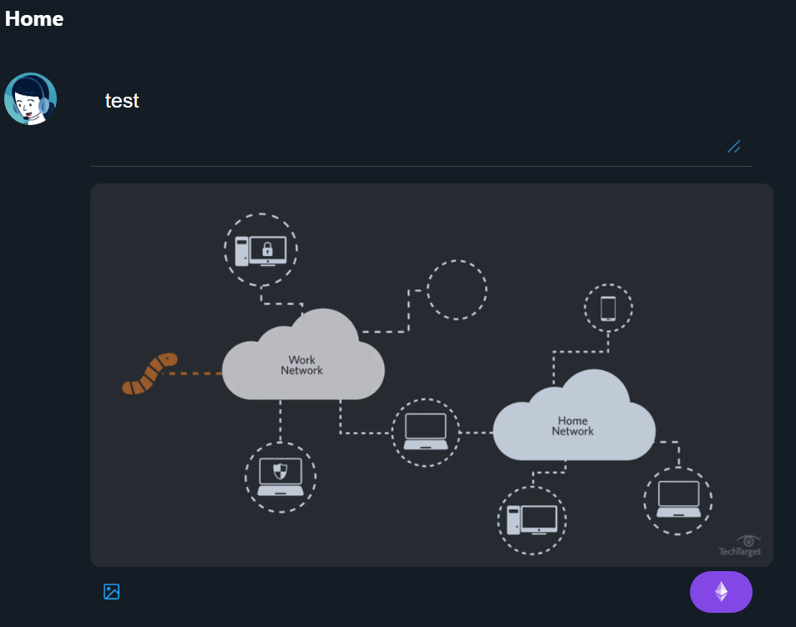
CREATE TWEET
You can create your tweet with text and image
Click Ether Icon to create your tweet

Slide 9
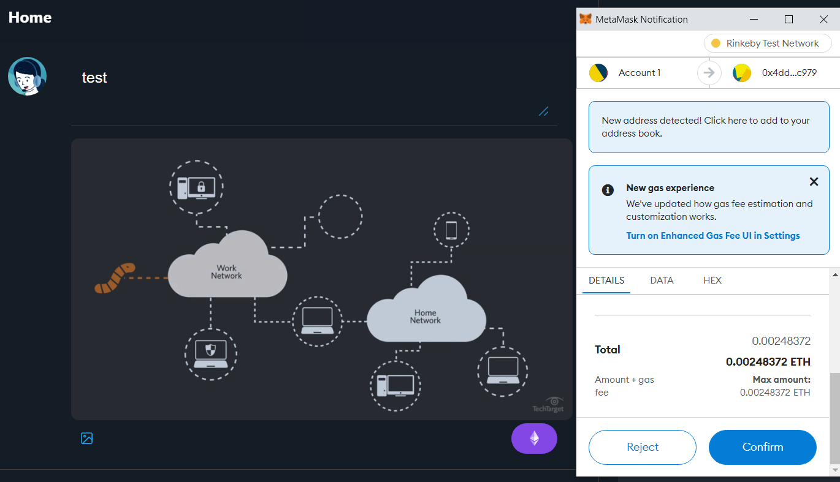
CREATE TWEET
You have to pay ether to create your tweet

Slide 10
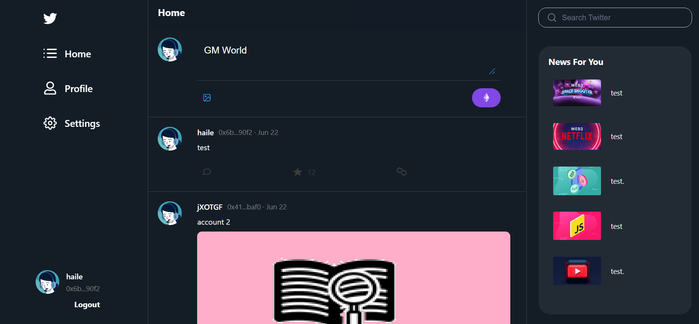
HOME PAGE

Slide 11
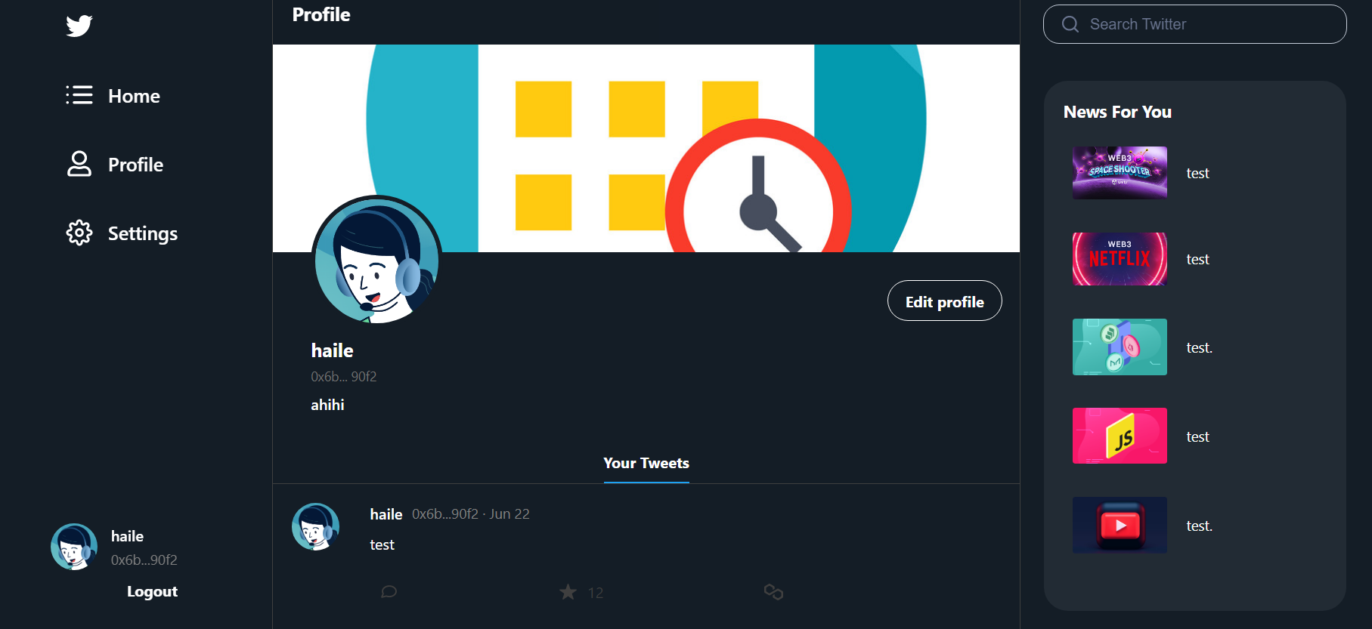
PROFILE PAGE

Slide 12
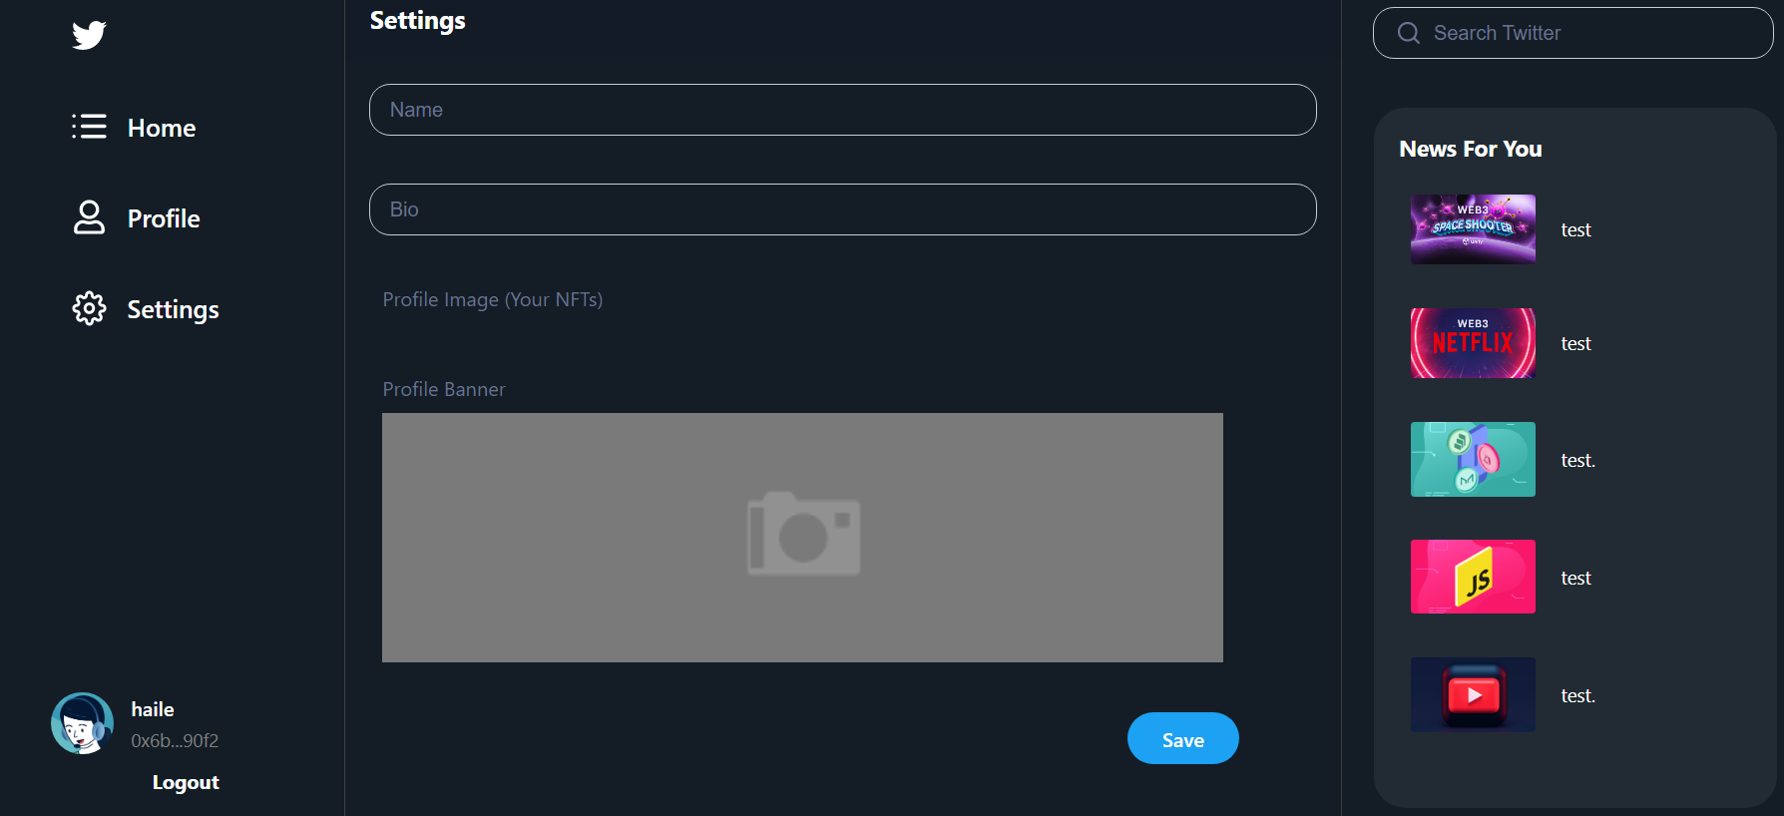
SETTING PROFILE
We’re trying to add NFT as Avatar

Slide 13
03
TECHNOLOGY
All tool and framework

Slide 14



TECHNOLOGY
Ethereum
Solidity
Smart Contract

Slide 15



TECHNOLOGY
Local Blockchain
Complie & Deploy Smart Contract
Moralis

Slide 16


TECHNOLOGY
Authentication
Moralis
Interact with Smart Contract in Front-end

Slide 17
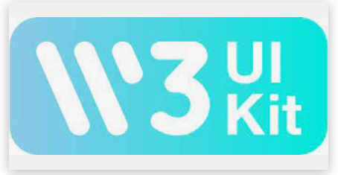
TECHNOLOGY
Web3 UI Kit For Icon, Button, …

Slide 18
THANKS
Does anyone have any questions?

